Slide 1

COMP 53 – Week Five
Polymorphism
Templates

Slide 2
Topics
Virtual Functions
Abstract Classes
Function Templates
Class Templates

Slide 3
Why Do We Care
More Power!
Dynamic programming provides more flexibility
More Code Re-use and Standardization

Slide 4
Virtual Function Basics
Polymorphism
Associating many meanings to one function
Virtual functions provide this capability
Fundamental principle of object-oriented programming!
Virtual
Existing in "essence" though not in fact
Virtual Function
Can be "used" before it’s "defined"

Slide 5
Figure Class Inheritance
Figure
Circle
Triangle
Rectangle
Base Class
Different properties such as height, length, radius
Each implements a draw method
Notes:
Classes for several kinds of figures
Rectangles, circles, ovals, etc.
Each figure an object of different class
Rectangle data: height, width, center point
Circle data: center point, radius
All derive from one parent-class: Figure
Require function: draw()
Different instructions for each figure

Slide 6
Draw Method Usage
Each class needs different draw function
Can be called "draw" in each class, so: Rectangle r; Circle c; r.draw(); //Calls Rectangle class’s draw c.draw(); //Calls Circle class’s draw

Slide 7
Issue – Need Multiple Center Methods
Figure::center() function is responsible to center objects on screens. It calls the draw() function
There are multiple draw() functions
But draw() method belongs to child classes
Notes:
Parent class Figure contains functions that apply to "all" figures; consider: center(): moves a figure to center of screen
Erases 1st, then re-draws
So Figure::center() would use function draw() to re-draw
Complications!
Which draw() function?
From which class?
Consider new kind of figure comes along: Triangle class derived from Figure class
Function center() inherited from Figure
Will it work for triangles?
It uses draw(), which is different for each figure!
It will use Figure::draw() → won’t work for triangles
Want inherited function center() to use function Triangle::draw() NOT function Figure::draw()
But class Triangle wasn’t even WRITTEN when Figure::center() was! Doesn’t know "triangles"!

Slide 8

Virtualization is the Answer!
Objective is to tell the compiler:
"Don’t know how function is implemented"
"Wait until used in program"
"Then get implementation from object instance"
AKA late binding or dynamic binding
Virtual functions implement late binding
Tells compiler to "wait" until function is used in program
Decide which definition to use based on calling object

Slide 9
Virtual Functions Auto Part Sales Example (1 of 4)
Record-keeping program for automotive parts store
Track sales
Don’t know the different kinds of sales or bills
Regular retail sales
Discount sales
Mail-order, etc.
Depend on other factors besides just price, tax
Program requirements:
Compute daily gross sales
Calculate largest/smallest sales of day
Perhaps average sale for day
So function for "computing a bill" will be virtual!

Slide 10
Class Sale Definition Auto Part Sales Example (2 of 4)
.cpp file
Header file
class Sale { public: Sale(); Sale(double thePrice); double getPrice() const; virtual double bill() const; double savings(const Sale& other) const; private: double price; };
double Sale::savings(const Sale& other) const { return (bill() – other.bill()); }
bool operator < (const Sale& first, const Sale& second) { return (first.bill() < second.bill()); }
Double bill() {
Return price; }
Note – both methods call the bill function
Notes:
Represents sales of single item with no added discounts or charges.
Notice reserved word "virtual" in declaration of member function bill
Impact: Later, derived classes of Sale can define THEIR versions of function bill
Other member functions of Sale will use version based on object of derived class!
They won’t automatically use Sale’s version!
Qualifier "virtual" does not go in actual function definition
"Automatically" virtual in derived class
Declaration (in interface) not required to have "virtual" keyword either (but usually does)

Slide 11
Derived Class DiscountSale Defined Auto Part Sales Example (3 of 4)
class DiscountSale : public Sale { public: DiscountSale(); DiscountSale(double thePrice, double the Discount); double getDiscount() const; void setDiscount(double newDiscount); double bill() const; private: double discount; };
double DiscountSale::bill() const { double fraction = discount/100; return (1 - fraction)*getPrice(); }

Slide 12
Sample Auto Parts Main Auto Part Sales Example (4 of 4)
Sale s1(100);
DiscountSale d1(110, 10);
cout << "sale price = " << s1.getPrice() << endl;
cout << "discount price = " << d1.getPrice() << endl;
if (d1 < s1)
cout << "d1 is cheaper by $" << s1.savings(d1) << endl;
else
cout << "s1 is cheaper by $" << s1.savings(d1) << endl;
Call to savings “understands” that d1 is a discount object

Slide 13
Parent Level Access to Child Functions
Key Point – Code written in the parent class will invoke the virtual function code in the child class. (Opposite of inheritance)
The operator method in parent calls the bill method in the child even though the parent is the input parameter.
Sale
Savings()
Operator <()
Discount Sale
Bill() {…}
Notes:
DiscountSale’s member function bill() implemented differently than Sale’s
Particular to "discounts"
Member functions savings and "<"
Will use this definition of bill() for all objects of DiscountSale class!
Instead of "defaulting" to version defined in Sales class!

Slide 14
Overriding versus Redefined
Looks the same – same signature!
Virtual function definition changed → overridden
Regular (non-virtual) methods → redefined
Virtual disadvantage: overhead!
Uses more storage
Late binding is "on the fly", so programs run slower

Slide 15
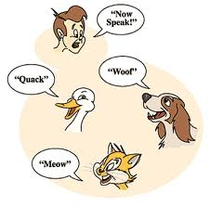
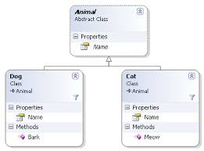
Virtual Function Practice class definitions
Define a Pet class
Protected Property : string name
Methods
Default constructor – set name = “none”
General constructor – set name to input parameter
Getter method for name
Virtual function string speak() – returns “???”
Define a Cat class
Methods – general constructor that calls parent general constructor. Function string speak() – returns “Meow”
Define a Dog class
Methods – general constructor that calls parent general constructor. Function string speak() – returns “Bark!”

Slide 16
Virtual Function Practice main program
Define a main.cpp
Include both cat.h and dog.h
Declare three variables – Pet p1, Cat c1(“name”), Dog d1(“name”)
Call the report function for each variable
Create a void function called report
Input parameter is type Pet (by reference!)
Cout the variable names and speak methods

Slide 17
Topics
Virtual Functions
Abstract Classes
Function Templates
Class Templates

Slide 18
Pure Virtual Functions
Base class methods might not have a real purpose
It’s meant solely for others to derive from
Example – figure draw()
All figures are objects of derived classes
Rectangles, circles, triangles, etc.
Class Figure has no idea how to draw!
Make it a pure virtual function (does not need code!): virtual void draw() = 0;
Classes with pure virtual functions
AKA Abstract Base Class
Can’t define any objects for a base class
Notes:
Pure virtual functions require no definition
Forces all derived classes to define "their own" version
Class with one or more pure virtual functions is: abstract base class
Can only be used as base class
No objects can ever be created from it
Since it doesn’t have complete "definitions" of all it’s members!
If derived class fails to define all pure’s:
It’s an abstract base class too

Slide 19
Final Note on Inheritance and Polymorphism
Inheritance goes only in one direction
A “dog” is a “pet”, BUT
A “pet” is not a “dog”
Example
Pet p1;
Dog d1(“Sparky”);
p1 = d1; // this is OK
d1 = p1; // not OK!

Slide 20
Slicing Problem
Notice value assigned to vpet "loses" it’s breed field!
cout << vpet.breed;
Produces ERROR msg!
Called slicing problem
Might seem appropriate
Dog was moved to Pet variable, so it should be treated like a Pet
And therefore not have "dog" properties
Makes for interesting philosphical debate

Slide 21
Slicing Problem Fix
In C++, slicing problem is nuisance
It still "is a" Great Dane named Tiny
We’d like to refer to it’s breed even if it’s been treated as a Pet
Can do so with pointers to dynamic variables

Slide 22
Slicing Problem Example
Pet *ppet; Dog *pdog; pdog = new Dog; pdog->name = "Tiny"; pdog->breed = "Great Dane"; ppet = pdog;
Cannot access breed field of object pointed to by ppet: cout << ppet->breed; //ILLEGAL!

Slide 23
Slicing Problem Example
Must use virtual member function: ppet->print();
Calls print member function in Dog class!
Because it’s virtual
C++ "waits" to see what object pointer ppet is actually pointing to before "binding" call

Slide 24
Virtual Destructors
Recall: destructors needed to de-allocate dynamically allocated data
Consider: Base *pBase = new Derived; … delete pBase;
Would call base class destructor even though pointing to Derived class object!
Making destructor virtual fixes this!
Good policy for all destructors to be virtual

Slide 25
Topics
Virtual Functions
Abstract Classes
Function Templates
Class Templates

Slide 26
Template Basics
Allow very "general" definitions for functions and classes
Ignore data types during coding
Type names are "parameters" instead of actual types
Compiler only generates definitions when required
Scans through all calls and then generates new overloads
But it’s "as if" you’d defined for all types
Precise definition determined at run-time
Write one definition → works for all types that might be needed

Slide 27
Function Templates
Standard Definition void swapValues(int& var1, int& var2) { int temp; temp = var1; var1 = var2; var2 = temp; }
Applies only to int variables
But code should work for any types!
Overload option for chars: void swapValues(char& var1, char& var2) { char temp; temp = var1; var1 = var2; var2 = temp; }
Code is nearly identical!
Only difference is data type

Slide 28
Function Template Syntax
Allow "swap values" of any type variables: template<class T> void swapValues(T& var1, T& var2) { T temp; temp = var1; var1 = var2; var2 = temp; }
First line called "template prefix"
Tells compiler what’s coming is "template"
And that T is a type parameter
Don’t get confused by the class keyword. Another keyword is typename
The datatype T is replaced at runtime with the actual one
Notes:
Recall: template<class T>
In this usage, "class" means "type", or "classification"
Can be confused with other "known" use of word "class"!
C++ allows keyword "typename" in place of keyword "class" here
But most use "class" anyway
Again: template<class T>
T can be replaced by any type
Predefined or user-defined (like a C++ class type)
In function definition body:
T used like any other type
Note: can use other than "T", but T is "traditional" usage

Slide 29
Calling a Function Template
Call syntax:
int int1=100, int2=50; swapValues(int1, int2);
C++ compiler "generates" function definition for two int parameters using template
Needn’t do anything "special" in call
Required definition automatically generated

Slide 30
Defining Templates Strategies
Develop function normally
Using actual data types
Completely debug "ordinary" function
Convert to template
Replace type names with type parameter as needed
Advantages:
Easier to solve "concrete" case
Deal with algorithm, not template syntax

Slide 31
Function Template Practice
Create a template function to sum up the total value of the array elements. Input parameters would be the array and the size. It should return the total
The main() function should define two arrays of different data types and then call the sumArray() function.

Slide 32
Multiple Type Parameters
Multiple substitution template<class T1, class T2>
Usually only need one "replaceable" type
Cannot have "unused" template parameters
Each must be "used" in definition
Error otherwise!

Slide 33
Inappropriate Types in Templates
Can use any type in template for which code makes "sense"
Code must behave in appropriate way
e.g., swapValues() template function
Cannot use type for which assignment operator isn’t defined
Example: an array: int a[10], b[10]; swapValues(a, b);
Arrays cannot be "assigned"!

Slide 34
Topics
Virtual Functions
Abstract Classes
Function Templates
Class Templates

Slide 35
Class Templates
Can also "generalize" classes template<class T>
Can also apply to class definition
All instances of "T" in class definition replaced by type parameter
Just like for function templates!
Once template defined, can declare objects of the class

Slide 36
Class Template Definition
template<class T> class Pair { public: Pair(); Pair(T firstVal, T secondVal); void setFirst(T newVal); void setSecond(T newVal); T getFirst() const; T getSecond() const; private: T first; T second; };
template<class T> Pair<T>::Pair(T firstVal, T secondVal) { first = firstVal; second = secondVal; } template<class T> void Pair<T>::setFirst(T newVal) { first = newVal; }
Notes:
Derived template classes
Can derive from template or nontemplate class
Derived class is then naturally a template class
Syntax same as ordinary class derived from ordinary class

Slide 37
Template Class Pair
Objects of class have "pair" of values of type T
Each member definition is itself a "template"
Class name before :: is "Pair<T>"
Not just "Pair"
But constructor name is just "Pair"
Destructor name is also just "~Pair"
Can then declare objects: Pair<int> score; Pair<char> seats;
Example uses: score.setFirst(3); seats.setFirst(‘A’);

Slide 38
Function Templates & Class Templates
Need a function to add up the two values in the class
template<class T> T addUp(Pair<T>& thePair) { T sum = thePair.getFirst() + thePair.getSecond();
return sum; }
Function now applies to all kinds of numbers
Assumes that operator + makes sense for data type
Notes:
Consider: int addUP(const Pair<int>& the Pair);
The type (int) is supplied to be used for T in defining this class type parameter
It "happens" to be call-by-reference here
Again: template types can be used anywhere standard types can

Slide 39
Template Practice
Define the pair class on the previous slides
Remember to specify Template <class T> at top of .h file
Add Template <class T> & Pair<T>:: for every method in the .cpp file
Provide code for general constructor, setter and getters
Add a print() method to display both properties
In main.cpp file
Include both the .h and the .cpp file (see note below)
Define two pair variables – one of int and one of string
Implement the addUp function and display results
Create a compare function – returns
0 if values are the same
1 if first > second
2 second > first
Notes:
When the compiler encounters a declaration of a TestTemp object of some specific type, e.g., int, it must have access to the template implementation source. Otherwise, it will have no idea how to construct the TestTemp member functions. And, if you have put the implementation in a source (TestTemp.cpp) file and made it a separate part of the project, the compiler will not be able to find it when it is trying to compile the client source file. And, #includeing the header file (TestTemp.h) will not be sufficient at that time. That only tells the compiler how to allocate for the object data and how to build the calls to the member functions, not how to build the member functions. And again, the compiler won't complain. It will assume that these functions are provided elsewhere, and leave it to the linker to find them. So, when it's time to link, you will get "unresolved references" to any of the class member functions that are not defined "inline" in the class definition.

Slide 40
A Look Behind the Curtain
You are already using template classes!
basic_string template class
Deals with strings of "any-type" elements
basic_string<char> works for char’s basic_string<double> works for doubles basic_string<YourClass> works for YourClass objects
"string"
It’s an alternate name for basic_string<char>
All member functions behave similarly for basic_string<T>
basic_string defined in library <string>
Definition is in std namespace

Slide 41
Vectors
Vectors: "arrays that grow and shrink“ during program execution
Similar to array with base type
Stores sequence of base type values in memory
Syntax: vector<Base_Type>
Indicates template class
Any type can be "plugged in" to Base_Type
Produces "new" class for vectors with that type
Example declaration: vector<int> v;
Formed from Standard Template Library (STL) - template class

Slide 42
Vector Methods
vector<int> v;
Calls class default constructor (Empty vector object created)
Indexed like arrays for access
cout << v[0];
Adding elements
Use member function push_back(value)
Length of array – v.size()
Capacity of array – v. capacity()
Reserve memory block – v.reserve(32)
Member function size()
Returns current number of elements
Notes:
Member function capacity()
Returns memory currently allocated
Not same as size()
Capacity typically > size
Automatically increased as needed
If efficiency critical:
Can set behaviors manually
v.reserve(32); //sets capacity to 32
v.reserve(v.size()+10); //sets capacity to 10 more than size

Slide 43
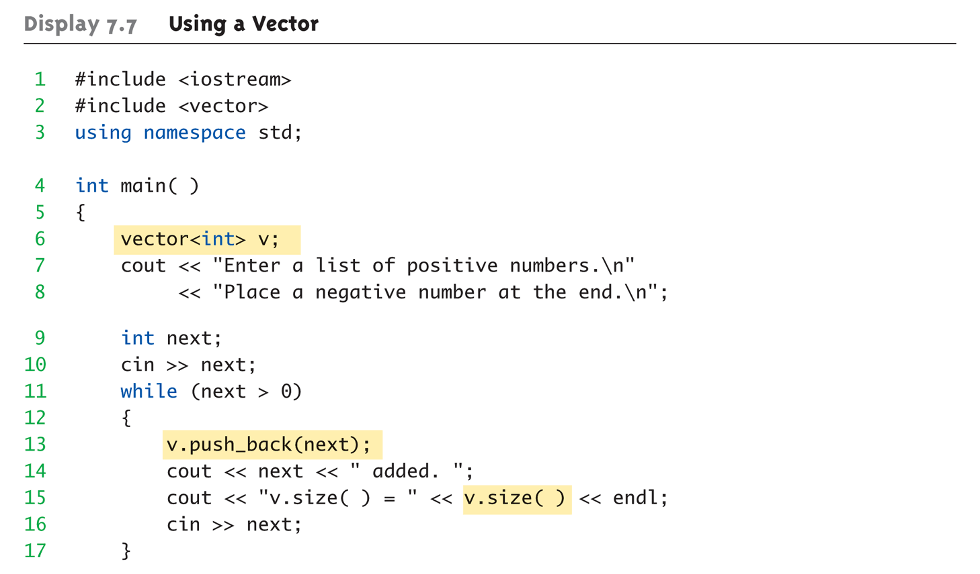
Vector Example: Using a Vector (1 of 2)

Slide 44
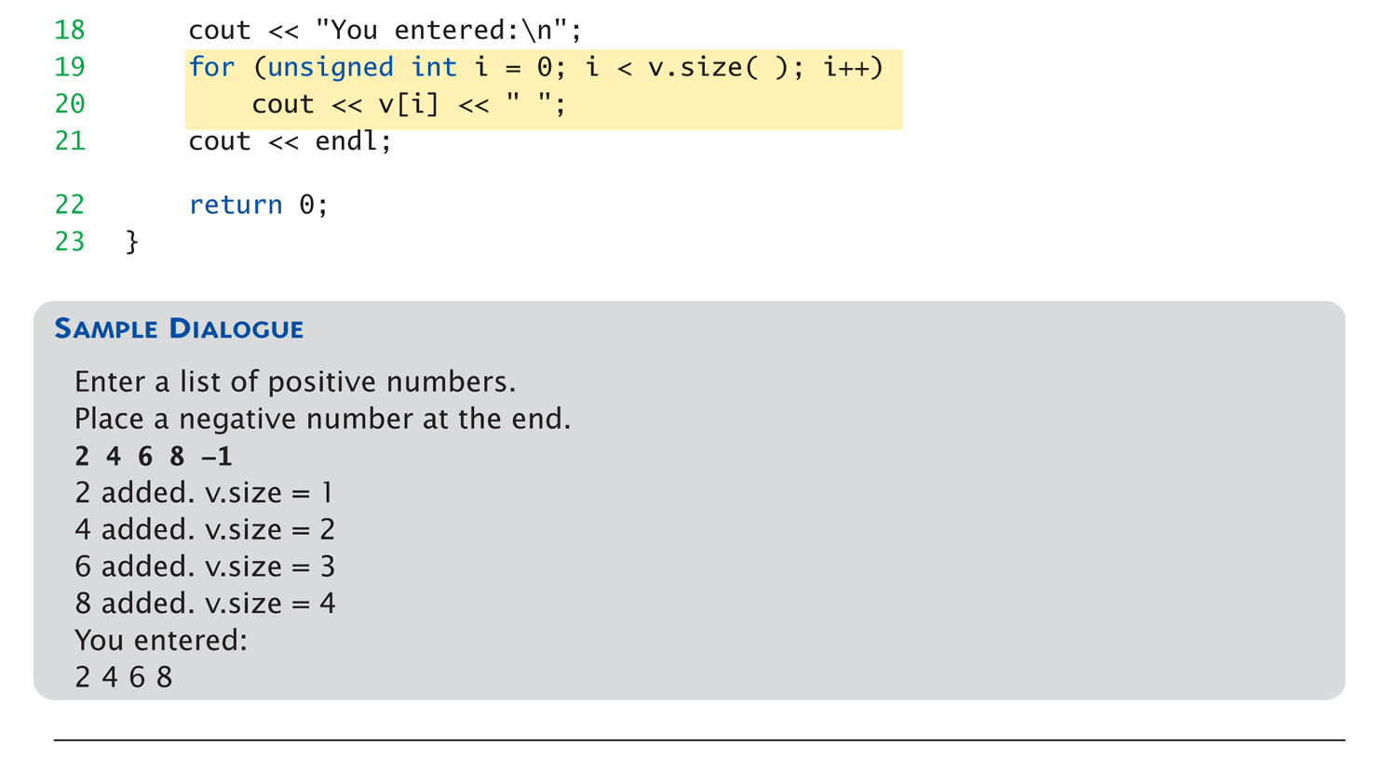
Vector Example: Using a Vector (2 of 2)

Slide 45
Iterators
Special operator that loops through a list of data
"Abstraction" of iterators
Designed to hide details of implementation
Provide uniform interface across different container classes
Each container class has "own" iterator type
Similar to how each data type has own pointer type

Slide 46
Vector Iterator Example
1 //Program to demonstrate STL iterators.
2 #include <iostream>
3 #include <vector>
4 using std::cout;
5 using std::endl;
6 using std::vector;
7 int main( )
8 {
9 vector<int> container;
10 for (int i = 1; i <= 4; i++)
11 container.push_back(i);
12 cout << "Here is what is in the container:\n";
13 vector<int>::iterator p;
14 for (p = container.begin( ); p != container.end( ); p++)
15 cout << *p << " ";
16 cout << endl;
17 cout << "Setting entries to 0:\n";
18 for (p = container.begin( ); p != container.end( ); p++)
19 *p = 0;
Iterator definition as a pointer

Slide 47
Vector Iterator Example
20 cout << "Container now contains:\n";
21 for (p = container.begin( ); p != container.end( ); p++)
22 cout << *p << " ";
23 cout << endl;
24 return 0;
25 }
Sample Dialogue
Here is what is in the container:
1 2 3 4
Setting entries to 0:
Container now contains:
0 0 0 0

Slide 48
Key Takeaways
Virtual functions implement ___________ delays decision of which member function is called until runtime
Getting abstract also mean being pure – having a pure function definition (no definition) → no instances of class
Make all destructors virtual
Good programming practice
Ensures memory correctly de-allocated
Templates are also _____________
Function templates can be a generic type
Class templates have parameters for subparts of class
For more info - http://www.youtube.com/watch?v=7T3_50ijESU

